Slide 1
Adopting narrative inquiry as a research methodology: telling my story
Faculty of Arts
School of Cultures, Languages and Linguistics
Morena Botelho de Magalhães
PhD candidate
m.magalhaes@auckland.ac.nz
Notes:
Narrative research inevitably involves the telling of stories (Barkhuizen, 2013; Barkhuizen et al., 2014; Bridges, 2006; Clandinin & Connelly, 2000; Riessman, 2008).
In my talk today I would like to share parts of my story with you, that of a doctoral student who decided to approach her research project from a narrative inquiry stance. I am still in the early stages of my PhD, and will draw on the work of prominent scholars to illustrate some of the aspects of narrative inquiry which I have been thinking about.
But firstly, if you allow me, I would like to tell you a bit about myself as I feel it is relevant to my research topic and to my reasons for choosing narrative inquiry as a research methodology.

Slide 2
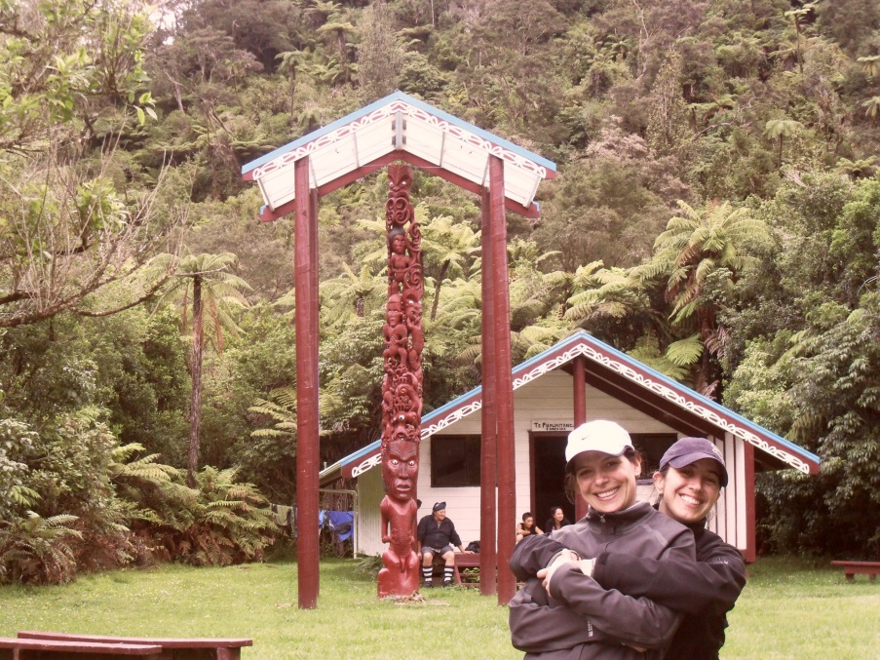
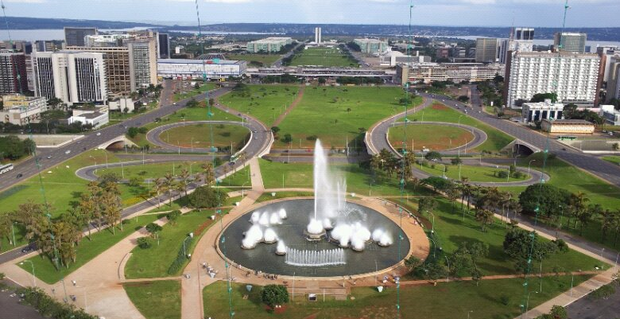
Notes:
I was born in Germany to Brazilian parents but only stayed a few days in that country. My mother, who is actually half French, wanted to try living in Paris for a while, but it didn’t work out. After only a couple of months we returned to Rio de Janeiro, my parents’ hometown. Consequently, I grew up in Brazil, not on the beaches of Rio, but on the plateaus of the newly built federal capital, Brasilia. At 17 I went to the UK and lived in London for two years; this experience changed me profoundly as I went from being able to speak only Portuguese and some French to having to learn English while also learning Spanish since it was the main language of the house where I was living. I returned to Brazil, where I did my BA in Brazilian and Portuguese literature and worked (mainly in the private foreign language teaching industry), until I decided to try my luck in New Zealand; that was eight years ago. I did my masters at the University of Auckland and I am now doing a PhD there. Out of curiosity, Morena, my name, means morning in Maori, the language of New Zealand’s native people, and I was amazed when I learnt this.
Well, as I said, living abroad as a young adult had a great impact on me. It was my first experience of identifying myself as a speaker of another language.

Slide 3
Language identity: ‘the relationship between one’s sense of self and different means of communication, understood in terms of language’ (Block, 2007: 43)
Language difficulties impacting on effective relationships between supervisors and doctoral candidates, and progress in general. (von Randow & Clemeau, forthcoming)
Notes:
According to Block (2007: 43), language identity is ‘the relationship between one’s sense of self and different means of communication, understood in terms of language’.
Living in England definitely impacted on my sense of self and it was because of having lived there that I started teaching English, for example.
For my doctoral thesis, I will investigate the experiences of fellow PhD candidates, who also have English as additional language, in the first year of their doctoral programme. More specifically, my participants will be doctoral students who will have to work on their English language skills as part of a set of goals to be accomplished by the end of their first year, or provisional year as we call it.
At the University of Auckland, all doctoral students do a diagnostic assessment right at the beginning of their first year, and those identified as in need of ‘further language development attend an advisory session to discuss appropriate academic English enrichment programmes and set specific goals to be achieved by the end of their provisional year’ (von Randow & Clemeau, forthcoming: abstract).This policy was introduced in 2011 ‘in response to research by the School of Graduate Studies suggesting that language difficulties often impacted on effective relationships between supervisors and their doctoral candidates and progress in general’(von Randow & Clemeau, forthcoming: abstract).

Slide 4
DELNA – Diagnostic English Language Needs Assessment
Screening (online)
Diagnosis (pen & paper: reading, listening and writing)
Advice and language enrichment
Notes:
The post-entry language assessment doctoral candidates do at The University of Auckland is DELNA - Diagnostic English Language Needs Assessment. DELNA has been in place since 2002 and was developed to identify linguistic needs of students beginning university study given concerns ‘about the increasing linguistic diversity of the student body’ (Read, 2013: 6).
DELNA - 2 tiers: the Screening and the Diagnosis (explain in detail).
All doctoral students who do the Diagnosis attend an advisory session and discuss language enrichment options.
I first came across DELNA in a Language Assessment paper I did for my masters in Language Teaching (etc… summer scholarship, Master’s dissertation, now I’m the administrator).
That is to say I was already working at DELNA when the language provision for doctoral candidates was put into effect. After the requirement was implemented, I began to see more and more students like me come to us for advice. Before: mainly young adults, some very excited about beginning university, others terrified by the same reason. But after we started attending to all doctoral candidates who did the DELNA Diagnosis, I noticed that more mature people, not only in age but also in attitude, with high level of oral proficiency at times, were knocking at our doors… and I began to think about these people’s experiences, about how they were feeling, about how they would they manage a language programme while also having to cope with the other demands of their doctoral programme, and whether that impacted on what they thought about themselves, their language abilities…
It was with questions like these in mind that I started to envision a research project for a PhD. My own experiences as a student with English as an additional language (EAL) also motivated me; like them I too had to work on my English to be where I am; like them, I know how frustrating it is when you do the best you can trying to express yourself and yet your ideas seem to simply get lost in translation...
So, I had some idea of what it was that I wanted to investigate, but not much idea on how to go about finding out what I thought I wanted to find out.

Slide 5
I am ‘more convinced by a richly described individual case study than by statistical analysis of experimental data collected from large numbers of people’, and I believe that ‘we can best understand the social forces that condition language teaching and learning behaviour by understanding how individuals interpret and respond to them’ (Barkhuizen et al., 2014: 3).
Notes:
One thing I knew though, and I’m quoting Barkhuizen, Benson and Chik (2014: 3) here, was that I was ‘more convinced by a richly described individual case study than’ I was ‘by statistical analysis of experimental data collected from large numbers of people’. I also believe that (and I’m quoting again) ‘we can best understand the social forces that condition language teaching and learning behaviour by understanding how individuals interpret and respond to them’.
It was clear to me then that I was interested in the human aspect of the language requirement recently introduced at my University.

Slide 6
Why a narrative approach?
Me in the ‘research puzzle’ (Clandinin & Connelly, 2000: 40)
Second language identity: ‘any aspect of a person’s identity that is related to their knowledge, learning, or use of a second language’ (Benson, 2013: 245)
Narratives: ‘a great way to get at identities’ (Bernard & Ryan, 2010: 252)
Notes:
I needed to work with a research approach that would allow me to connect with participants while also letting me be “in the picture” as I did not want to remove myself from the ‘research puzzle’ (Clandinin & Connelly, 2000: 40) to be investigated.
I also wanted to make sure I would be able to capture the students’ perspectives on their experiences of having to work on their language skills, and thought that the theme of language identities would probably surface in the process.
Second language identity, as proposed by Benson (2013: 245), is ‘any aspect of a person’s identity that is related to their knowledge, learning, or use of a second language’.
How did these doctoral students perceive their language abilities? How did they negotiate subject expertise and being able (or not) to express their knowledge in a second language? These were some of the things I wanted to find out, amongst others, and narrative inquiry seemed to be the perfect way to approach my research project. After all, narratives, as stated by Bernard and Ryan (2010: 252), are ‘a great way to get at identities’.
But what is narrative inquiry, I often wondered…

Slide 7
Narrative Inquiry (i)
Barkhuizen:
‘Narrative and narrative research are notoriously hard to define.’ (2013: 2)
Storytelling is both a social activity and a cognitive activity. (2013)
Narrative knowledging: ‘the meaning making, learning, or knowledge construction that takes place during narrative research activities of (co)constructing narratives, analysing narratives, reporting the findings, and reading/watching/listening to research reports’ (2011: 395)
Notes:
Barkhuizen (2013: 2) says that ‘narrative and narrative research are notoriously hard to define’. However, soon after affirming this, the author presents some useful descriptions of narrative, selected because they capture some core meanings of the topic.
Essentially, the act of storytelling is a social activity: ‘the narrator addresses an audience when constructing a narrative in a social context’ (Barkhuizen, 2013: 4); temporality is important as ‘in the process of narration the narrator makes reference to experiences or events (the tale, or story)’ in terms of ‘space (another place)’ and also in terms of ‘time (past or an imagined future)’ (Barkhuizen, 2013: 3). Storytelling is also a cognitive activity, as ‘stories re-shape our experiences so that we can make meaning from them’; in other words, storytelling ‘makes experiences meaningful’ (Barkhuizen, 2013: 4).
Barkhuizen (2011) ‘tried to encapsulate these two aspects of narrative in the concept of narrative knowledging’ (Barkhuizen, 2013: 4), which he defines as (read quote from slide). This concept was important to me because it helped me realise that even though I did not know much about NI, I was already “doing narrative” in a sense. I’d like to think, for example, that me being here is a result of my own engagement with the activity of narrative knowledging.

Slide 8
First readings
Narrative inquiry: Experience and story in qualitative research (Clandinin & Connelly, 2000)
Narrative methods for the human sciences (Riessman, 2008)
Narrative configuration in qualitative analysis (Polkinghorne, 1995)
Exploring life and experience through narrative inquiry (Kramp, 2004)
Stories within stories: A narrative study of six international PhD researchers’ experiences of doctoral learning in Australia (Cotterall, 2011)
Notes:
Well, after deciding that I wanted to approach my project from a narrative instance, I began reading on the topic. Perhaps it should have been the other way round, but I was so impressed with the few narrative studies I had already read that I made that decision and stick to it even when my main supervisor did not seem convinced of my choices. I began with the “usual suspects”: Clandinin and Connelly’s (2000) Narrative inquiry: Experience and story in qualitative research, Riessman’s (2008) Narrative methods for the human sciences, and Polkinghorne’s article (1995) Narrative configuration in qualitative analysis. Kramp’s chapter (2004) Exploring life and experience through narrative inquiry was also of great relevance to me.
However, one piece of work that truly inspired me was Sara Cotterall’s (2011) longitudinal study on the experiences of six international PhD students in Australia.
Incidentally, I was lucky enough to hear Sara speak in the last Independent Learning Association Conference in Wellington, New Zealand, two years ago, and I remember thinking “this is it, this is how I want to do research”. Well, sometime after that Sara kindly sent her PhD thesis to my boss, Janet von Randow, who later passed it on to me, for which I’m grateful.
Although our projects have some similarities, I will focus solely on the experiences of candidates for whom academic language proficiency is an issue. The fact that my participants will be students identified as “in need of improving their language skills” will be central to my discussion, and I intend to look at this aspect of their doctoral experience in particular.

Slide 9
Narrative Inquiry (ii)
Barkhuizen, Benson and Chik (2014):
‘Narrative inquiry brings storytelling and research together either by using stories as research data or by using storytelling as a tool for data analysis or presentation of findings.’ (p.3)
Three distinctions within approaches to narrative inquiry: 1) analyses of narratives and narrative analysis; 2) autobiographical and biographical approaches; 3) focus on content and focus on language and discourse.
Notes:
Well, but going back to what narrative inquiry is. Barkhuizen, Benson and Chik (2014: 3) state that ‘Narrative inquiry brings storytelling and research together either by using stories as research data or by using storytelling as a tool for data analysis or presentation of findings’. In their book Narrative Inquiry in Language Teaching and Learning Research, they analysed ‘a database of more than 175 papers on language teaching and learning in which narrative plays an important part’ (2014: 7), and grouped some of the articles according to their ‘overall approach to narrative and narrative inquiry’ (2013: 8). They also talk about ‘three distinctions within approaches to narrative inquiry’ (Barkhuizen et al., 2014: 9): (1) Polkinghorne’s (1995) “analyses of narratives”, ‘research in which stories are used as data’, and “narrative analysis”, ‘research in which storytelling is used as a means of analysing data and presenting findings’ (2014: 3); ‘(2) autobiographical and biographical approaches, and (3) focus on content and focus on language and discourse’ (2014: 9).
For those of you who have read Barkhuizen, Benson and Chik’s new book, you will see that most of my talk today is based on the ideas they have put together in this year’s publication. This is because their book is interesting, clear, and informative, but most importantly it provides concrete examples of narrative research that has been done and published in the field of language teaching and learning. I found it so useful that sometimes I wish it had been published a year before it actually was as it would have made the beginning of my narrative research journey much easier…
Well, according to Barkhuizen, Benson and Chik (2014), narrative inquiry can be applied to any topic in the field of language teaching and learning, depending on the researcher’s creativity. For me, one of its appeals was the flexibility, the fact that I did not need to be sure of where I was going; Clandinin and Connelly (2000) say that we cannot have precise questions at the beginning of a narrative project since specific themes and issues arise as we are doing the research. This ‘fluidity of approach or lack of definitive methodological guidelines’ (Barkhuizen et al., 2014: 114) was, for me, a plus. The fact that identity features prominently in narrative studies of language teaching and learning (Barkhuizen et al., 2014) also told me that I had chosen a suitable research approach for the study I want to carry out.

Slide 10
Narrative data
Collected in a variety of forms:
Oral narratives (e.g. interviews)
Written narratives (e.g. diaries, language learning histories, reflective journals, narrative frames)
Multimodal narratives (e.g. photographs, drawings)
Notes:
Narrative data in studies of language teaching and learning may be collected in a variety of forms: oral narratives, written narratives, and multimodal narratives, and data can be elicited in different ways. With oral narratives, for example, interviews are commonly used to elicit accounts; written narrative data may be collected in the form of diaries, language learning histories, reflective journals and narrative frames, while multimodal narratives may include visual components, such as photographs or drawings, which can be used as both a subject or a tool in a particular study (Barkhuizen et al., 2014).
In my study, I will work mainly with oral narrative data to be collected in multiple interviews with each participant.
One important aspect of oral data collection is the language in which interviews are conducted.

Slide 11
Interviews: language and transcription
‘Ideally, narrative studies would be carried out in a shared first language, but it is in the nature of second language learning research that this will rarely be possible.’ (Benson, 2013: 249)
‘In not personally listening to and transcribing the narrative interviews, I would have been neglecting an integral stage in the process of gaining understanding about the study’s focus.’ (Hacker, 2008: 86)
Notes:
Benson (2013: 249) stated: ‘Ideally, narrative studies would be carried out in a shared first language, but it is in the nature of second language learning research that this will rarely be possible’. When researchers do not speak their participants’ first language proficiently, they may opt for using translated data if they think participants would express themselves more eloquently, and thus provide more detailed accounts, in their first language. Benson (2013: 250), for example, in his work context has ‘found that problems associated with the use of translated data are outweighed by the quality of the data itself’.
In my study my participants and I will share a second language (or 3rd, 4th for some people). I wish to get as close as possible to the people I will be working with, so I will conduct all interviews. I know it is very unlikely that we will be able to resort to any other language rather than English (unless I find speakers of Portuguese, Spanish or French), but I have the impression that because English is not my first language either, we will be able to relate to one another and hopefully lessen the distance sometimes seen in the researcher-participant relationship.
For the same reason, that of wanting to connect with my participants and their stories, I will transcribe all the interviews. Penny Hacker makes a perceptive comment on her own transcribing process during her PhD research (read quote). And I think that this how I would feel if I decided not to transcribe my own interviews.

Slide 12
Data analysis (i)
Iterative, emergent and interpretive (Dörnyei, 2007)
‘Read, discuss and write about the data repeatedly and with an open mind’, but observe specific strategies to make the analysis more systematic or rigorous (Barkhuizen et al., 2014: 73).
Narrative or non-narrative data (Barkhuizen et al., 2014)
Notes:
Data analysis in qualitative research is said to be iterative, emergent and interpretive (Dörnyei, 2007).
Barkhuizen, Benson and Chik advise narrative researchers to keep these terms in mind when analysing data. They also say that in many narrative studies, the basic approach is to read, discuss, and write about the data repeatedly and with an open mind, but that more specific strategies help make this basic approach more relevant to the form of the data, thus making the analysis more systematic or rigorous.
The first step, however, is to establish whether the data ‘is “narrative” or “non-narrative” in form’ (2014: 73). In their words: ‘The significance of this distinction lies in what happens next. Will the data analysis be a matter of analysing one or more narratives or will it be a matter of using narrative writing as a strategy to analyse non-narrative data?’ (Barkhuizen et al., 2014: 73). The authors caution readers about this distinction being ‘fuzzy’, and usually coming down to ‘how researchers choose to look at their data’ (2013: 74).

Slide 13
Data analysis (ii) (adapted from Barkhuizen et al., 2014)
Analysing narrative data (“analysis of narratives” - Polkinghorne, 1995)
Focus on content: thematic analysis – what narratives tell
Focus on narrative discourse – how narratives are told (e.g. metaphors, narrative structure, narrative in interaction)
Narrative writing (“narrative analysis” - Polkinghorne, 1995; “restorying” - Clandinin & Connelly, 2000)
Notes:
When choosing to analyse narrative data, then there are usually two avenues for doing this. One possibility is to do it thematically. ‘Polkinghorne (1995) uses the term “paradigmatic” to describe the characteristic mode of analysis of narrative data’ (Barkhuizen et al., 2014: 74) and ‘identifies paradigmatic analysis with analysis of the “content” of narratives or what they say about their subject matter’ (2014: 75).
Another possibility is to analyse narrative discourse by, for example, looking at metaphors, the structure of narratives, or narrative in interaction, which deals only with short narratives that happen in natural spoken interaction (Barkhuizen et al., 2014).
Narrative writing can also be used as a data analysis strategy. We can craft narratives to help us make sense of the data collected in a narrative project. This is what Polkinghorne calls “narrative analysis” and Clandinin & Connelly refer to as “restorying”.
In my research proposal, I said that I would begin with thematic analysis and would also consider the possibility of using structural analysis, following Riessman’s (2008) suggestion of strengthening the thematic analysis of multiple narratives by investigating the way different participants construct their stories. As I mention before, not having to tie myself to a specific way of doing things was one of the pluses I found with narrative inquiry. I have an idea of how I would like to do things, but I am sure it will change the more I get involved in my project and the more I learn in the process. For example, I now know that it makes more sense to talk about narrative research in terms of a “more or less continuum” (Barkhuizen, 2013), even when thinking about the analysis of narrative data.

Slide 14
Findings
In narrative research ‘we are not looking for “objective” or “reliable” findings, but for a well-crafted, subjective interpretation of data, whether it comes in the form of a paradigmatic argument based on thematic or discourse analysis or in the form of a narrative written by a researcher.’ (Barkhuizen et al., 2014: 89)
‘The narrative inquirer does not prescribe general applications and uses but rather creates texts that, when well done, offer readers a place to imagine their own uses and applications.’ (Clandinin & Connelly, 2000: 42)
Notes:
When it comes to the “findings” of narrative inquiry studies, they are hardly ever “objective” because they do not offer statements or hypotheses that are ‘backed up by evidence of statistical significance’; on the contrary, there is ‘often an explicit acknowledgment that they are necessarily “subjective” and “interpretive” (Barkhuizen et al., 2014: 88). Barkhuizen, Benson & Chik say that in narrative research, ‘we are not looking for “objective” or “reliable” findings, but for a well-crafted, subjective interpretation of data, whether it comes in the form of a paradigmatic argument based on thematic or discourse analysis or in the form of a narrative written by a researcher’ (2014: 89). To cite Clandinin and Connelly (2000: 42) on this: ‘The narrative inquirer does not prescribe general applications and uses but rather creates texts that, when well done, offer readers a place to imagine their own uses and applications’.
Well, with that being said, it is not surprising that there are no standard formats when reporting narrative studies. However, one still has to be mindful of ethical issues not only in the data analysis processes but also in the presentation of the research outcomes (Barkhuizen et al., 2014).

Slide 15
Rigor, trustworthiness and generalizability
Barkhuizen et al., 2014:
Rigor – ‘the degree to which an analysis is systematic with regard to both the coverage of data and the application of analytical procedures’ (p. 89)
Trustworthiness – the ‘complex question of the relationship between the findings of narrative inquiry studies and the underlying “realities” they represent’ (p. 90)
Generalizability – how can ‘narrative studies contribute to our knowledge of language teaching and learning’? (p. 92)
Notes:
Citing Barkhuizen, Benson and Chik again, they say that researchers need to pay special attention to ‘issues to with rigor, trustworthiness, and generalizability’ (2014: 95), not only when analysing data, but also when presenting the findings of a study in a research report.
Generalizability is particularly interesting, I think, because as in much qualitative research, narrative inquiry studies usually focus on individual experiences and do not intend to generalize. But still, it is possible, as Barkhuizen, Benson and Chik say, to consider points of connection amongst different narratives exploring similar themes. We can also learn from narrative studies and inform our readers with rich descriptions of our own research context so that they can make their own reasoning and reach their own conclusions.

Slide 16
Reporting
Complex interrelationships among ‘six variables: the participant(s), the topic of the research, the researcher(s), the audience, the purpose of the research, and the form of the report’ (Barkhuizen et al., 2014: 96)
‘influenced by the values, preferences, skills and assumptions of the researcher’ (Bridges, 2006: 93)
Notes:
When reporting the process and findings of a narrative inquiry project, Barkhuizen, Benson & Chik say that researchers should ask themselves questions ‘to do with the complex interrelationships among the following six variables: the participant(s), the topic of the research, the researcher(s), the audience, the purpose of the research, and the form of the report’ because ‘it is their interrelationship’ that will shape ‘the final report’ (Barkhuizen et al., 2014: 96).
Bridges (2006: 93), on the other hand, says that ‘decisions about the nature’ of this reporting process ‘are influenced by the values, preferences, skills and assumptions of the researcher’.
As I said before, apparently there is no standard format when it comes to presenting one’s findings in narrative studies, as there is no “recipe” for conducting a narrative study. Going back to ‘Polkinghorne's two broad approaches to analysis and reporting’, Barkhuizen (2013: 12) mentions that there is some similarity and overlap between them and that ‘many studies are a hybrid of the two; i.e. a coherent story and a discussion of separate, extracted themes’. In their Stories from Hong Kong, for example, Flowerdew and Miller (2013) do this. ‘They describe in detail the processes involved in the content analysis of narrative data’, and then retell their participants’ experiences ‘in the form of short narratives’ (Barkhuizen, 2013: 12).

Slide 17
Final thoughts
Consider theoretical and methodological issues that will arise in my own narrative project (e.g. Flowerdew & Miller, 2013)
NI ‘may be the cause of some concern or even anxiety’ for some, but for me it is ‘an opportunity to explore new methodological territory and to locate’ myself within it. (Barkhuizen et al., 2014: 114)
We can all find our own narrative path, our ‘own narrative adventure’ that emerges from our ‘particular context, culture and history’. (Bridges, 2006: 93)
Notes:
Also interesting to me is that Flowerdew and Miller (2013: 57) call attention to the fact that ‘a large number of theoretical and methodological issues arise in a narrative research project’, and list a few, which coincidentally match some of my own concerns: data collection (in particular the question of the language in which interviews are conducted), participant verification, and issues of identity.
So Flowerdew & MIller helped me realise the importance of paying attention to issues to do with my own narrative project.
I would to finish by making use of Barkhuizen, Benson and Chik’s words one more time and say that although the flexibility of narrative inquiry ‘may be the cause of some concern or even anxiety’ for some, for me it is comforting because I do not ‘feel the pressure to master a body of knowledge’ I am ‘unfamiliar with or need to understand to make progress’; I’m also hoping that narrative inquiry will allow me ‘an opportunity to explore new methodological territory and to locate’ myself within it (Barkhuizen et al., 2014: 114) because, as Bridges (2006: 93) points out, we can all find our own narrative path, our ‘own narrative adventure’ that emerges from our ‘particular context, culture and history’.
Thank you!

Slide 18
References
Barkhuizen, G. (2011). 'Narrative knowledging in TESOL’, TESOL Quarterly, 45,391-414.
Barkhuizen, G. (2013). Introduction: narrative research in applied linguistics. In G. Barkhuizen (Ed.), Narrative Inquiry in Applied Linguistics (pp. 1-16). Cambridge: Cambridge University Press.
Barkhuizen, G., Benson, P. & Chik, A. (2014). Narrative Inquiry in Language Teaching and Learning Research. New York: Routledge.
Benson, P. (2013). Narrative writing as method: second language identity development in study abroad. In G. Barkhuizen (Ed.), Narrative Inquiry in Applied Linguistics (pp. 244-263). Cambridge: Cambridge University Press.
Bernard, H. R. and Ryan, G. W. (2010). Analyzing Qualitative Data: Systematic Approaches, Los Angeles: Sage.
Block, D. (2007). Second Language identities. London: Continuum.
Bridges, N. (2006). Learning and Change through a Narrative PhD: a personal narrative in progress. In S. Trahar (Ed.), Narrative Research on Learning: comparative and international perspectives (pp. 93-105). Oxford: Symposium Books.
Clandinin, D. J., & Connelly, F. M. (2000). Narrative inquiry: Experience and story in qualitative research. San Francisco: Jossey-Bass.
Cotterall, S. (2011). Stories within stories: A narrative study of six international PhD researchers’ experiences of doctoral learning in Australia. Published doctoral thesis, Macquarie University, Australia.
Dörnyei, Z. (2007). Research Methods in Applied Linguistics: Quantitative, Qualitative, and Mixed Methodologies. Oxford: Oxford University Press.
Flowerdew, J. & Miller, L. (2013). Narrative inquiry in a second language context: stories from Hong Kong. In G. Barkhuizen (Ed.), Narrative Inquiry in Applied Linguistics (pp. 41-61). Cambridge: Cambridge University Press.
Hacker, P. (2008). Understanding the Nature of Language Teacher Educator Learning: Substance, Narrative Essence and Contextual Reality. Thesis submitted for the degree of Doctor of Philosophy in Language Teaching and Learning, Department of Applied Language Studies and Linguistics, The University of Auckland: Auckland.
Kramp, M. K. (2004). Exploring life and experience through narrative inquiry. In K. de Marrais, & S. D. Lapan (Eds.), Foundations for research: Methods of inquiry in education and the social sciences (pp. 103- 121). Mahwah, NJ: Lawrence Erlbaum.
Polkinghorne, D. E. (1995). Narrative configuration in qualitative analysis. International Journal of Qualitative Studies in Education, 8(1), 5-23.
Riessman, C. K. (2008). Narrative methods for the human sciences. London: Sage.
Von Randow, J. & Clemeau, E. (forthcoming). Doctoral candidates and DELNA: rising to the language challenge.

